Slide 1
Servers
Prepared by: Emadeldeen Abdallah
Supervisor: Dr. Mohamed Heshmat

Slide 2
Welcome

Slide 3
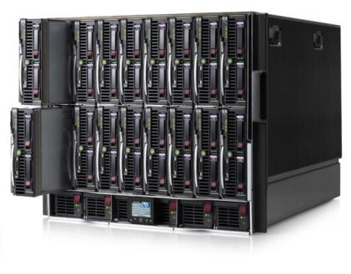
Servers Definition
A server is a system (software and suitable computer hardware) that responds to requests across a computer network to provide, or help to provide, a network service.

Slide 4
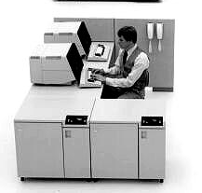
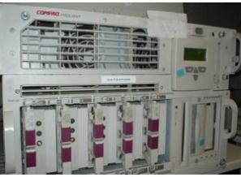
Servers history
IBM Virtual Machine mainframe
1991 First web server with a 256Mhz cpu, 2GB of disk
the first web page online on August 6, 1991
1994 Rack-Mountable servers

Slide 5
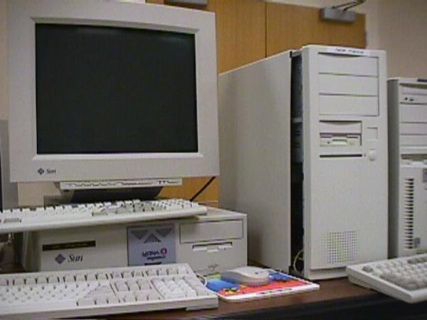
Servers history
This is Google’s first server,

Slide 6
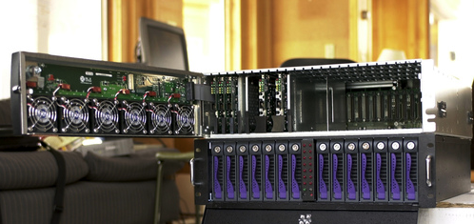
Servers history
2001 First modern blade servers

Slide 7
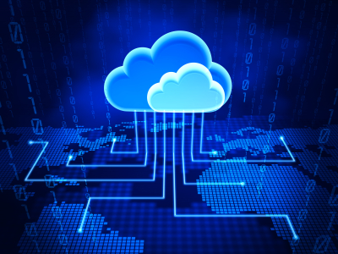
Servers history
2008 – 20013 The Cloud computing

Slide 8
Server hardware components
Typical server computer.
Built from higher-grade components than client computers.
More Ports

Slide 9
Motherboard
Importance of Motherboard
The major components on the motherboard include
processor (or CPU)
supporting circuitry called the chipset Memory
Slots
a standard IDE , SATA, SCSI hard drive controller
input/output (I/O) ports for devices such as keyboards, mice, and printers
additional built-in features
Graphics adapter.
SCSI disk controller.
network interface.

Slide 10
Hard drives
SATA drives
SCSI drives

Slide 11
Processor
The processor, or CPU, is the brain
It isn't the only that affects overall system performance
Intel had four processor models designed for use in server computers:
Itanium 2: 1.60GHz; 1–2 processor cores
Xeon: 1.83–2.33GHz; 1–4 processor cores
Pentium D: 2.66-3.6GHz; 2 processor cores
Pentium 4: 2.4-3.6GHz; 1 processor core

Slide 12
Memory
Many different types.
Pick the right type .
The total memory capacity.
At least 12GB of memory.

Slide 13
Network connection
Importance of adapters .
Built in Network adapters .
Separate network adapter card.

Slide 14
Video
Not Importance.
Cut costing.

Slide 15
Power supply
More devices requires a larger power supply.
(300 watts is typical).

Slide 16
UPS
UPS uninterruptible power supply
UPS definition
Save data
shut down the computer gracefully.
Automate backup then shut down.

Slide 17
Server Types

Slide 18
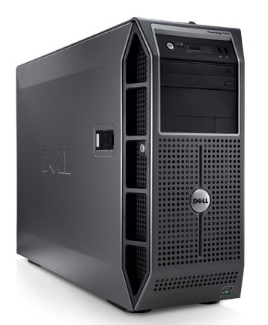
Tower Server
Advantage: the cabling can get messy.
Disadvantage Have no such features.

Slide 19
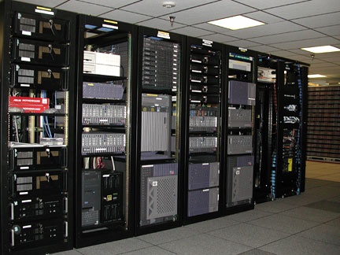
Rack Servers
Mounted within a rack.
Many hardware vendors.

Slide 20
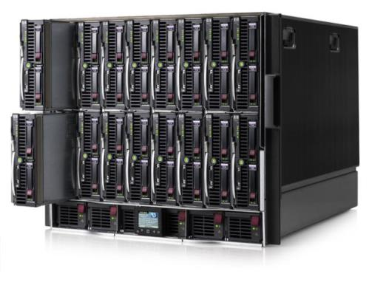
Blade Servers
Like rack servers.
Rack is known as a chassis.
One hardware vendors.
Less cable of rack server

Slide 21
Blade Servers
Is fully self-contained.
chassis might contain a power supply unit, a cooling unit, and a blade server

Slide 22
Deferent Between Servers and PC
1
2
Ports
4
Heat
Hardware Components
3
Rack
5
6
Mail Server
7
Full Remote Access
8
Centralization work
9
Group Network
Additional server

Slide 23
Server Benefits
1
2
Increased reliability
4
Centralized data storage and shared resources
File and Network security
3
decreased workflow interruptions
5
Virus Management

Slide 24
Server Hardware Company
1
2
DELL SERVER
3
Fujitsu
HP SERVER
4
Lenovo
5
IBM

Slide 25
Server Software
1
2
NAT Server
4
Application Server
DHCP Server
3
File Server
5
6
Mail Server
7
Active Directory Server
8
Web Server
9
Anti Virus Server
Print Server

Slide 26
Servers Operating Systems
1
2
Unix: UNIX SOLARIS
Windows Server NET, 2003, 2008, 2012
3
Linux: Fedora , SUSE,

Slide 27
Do I need a server ?

Slide 28
If you operate a small to medium-size business, the question
Isn’t
"Do I need a server?"
but is
"Which type of server do I need?

Slide 29
Thank you
for
your attention

